Slide 1
Mediq healthcare appointment system
VIVEK NAGARIYA IU2453000011
GUIDE : - KIRTAN RATHOD

Slide 2
Introduction
Healthcare industry needs integrated digital systems.
MEDIQ is a full-stack healthcare appointment system.
It connects:
Patients
Doctors
Administrators
It moves traditional hospital workflow into a digital environment.
It is developed using the MERN Stack.

Slide 3
Main Idea of MEDIQ
MEDIQ makes healthcare more accessible and organized.
Patients can easily find doctors and book appointments.
Doctors can manage appointments and patient details.
Admin can monitor and verify doctors.
The system reduces manual appointment handling.

Slide 4
Technical Foundation
MEDIQ uses a modern full-stack architecture.
Frontend works as a Single Page Application.
Backend handles APIs and business logic.
MongoDB stores system data securely.
The system supports scalability and future enhancements.

Slide 5
Key Features of MEDIQ
Online appointment booking
Doctor search and listing
Patient profile management
Doctor profile management
Admin-controlled doctor approval
Real-time chat support
Appointment tracking
Secure data storage

Slide 6
Organization Profile
Purushottam Solutions
Purushottam Solutions is an IT service company.
It provides website and mobile app development services.
The company focuses on user-friendly and scalable digital products.
It helps businesses improve their digital presence.
It follows modern design and development standards.

Slide 7
Organization Services
Services Provided
Website design and development
Mobile application development
UI/UX design
Web-based business solutions
Responsive and secure application development
Ongoing maintenance and support

Slide 8
Organization Development Process
Development Process
Requirement gathering
Planning and strategy
UI/UX design
Development and integration
Testing and quality assurance
Deployment
Maintenance and support

Slide 9
Existing System
Existing Healthcare Platforms
Practo
Apollo 24/7
Tata 1mg
MediBuddy
Lybrate

Slide 10
Practo
Practo
Provides doctor search and appointment booking.
Allows patients to find verified specialists.
Supports physical visits and video consultation.
Provides Practo Ray for health records, billing, and reminders.

Slide 11
Tata 1mg
Tata 1mg
Started as a digital pharmacy.
Provides medicine information and alternatives.
Allows doctor appointment booking.
Offers at-home diagnostic testing.
Improves healthcare transparency.

Slide 12
MediBuddy
MediBuddy
Integrated digital healthcare platform.
Focuses on corporate healthcare and personal care.
Provides virtual doctor consultation.
Offers hospital admission and surgical support.
Also supports dental appointment booking.

Slide 13
Lybrate
Lybrate
Provides health feed and doctor advice.
Allows doctors to answer patient questions.
Supports virtual and in-person appointments.
Gives access to many verified doctors.
Similar to chatbot-based medical support concept.

Slide 14
Apollo 24/7
Apollo 24/7
Digital platform of Apollo Hospitals.
Provides online doctor consultation.
Includes AI-powered symptom checker.
Offers lab test booking and medicine delivery.
Focuses on quick healthcare services.

Slide 15
Problems in Existing System
Problem Areas
Doctor verification is not always strong.
Some systems do not allow doctors to manage patient lists.
Many systems collect only basic patient details.
Patient records are scattered across different hospitals.
No separate dashboard for each role.
Limited chatbot service.
Admin cannot always control doctor registration.

Slide 16
More Problems
Additional Issues
Some platforms do not provide night-shift doctor services.
Fraud doctors may create trust issues.
Not all doctor categories are available.
Female patients may not easily find women doctors.
Consultation fees can be high.
Lack of complete hospital workflow management.

Slide 17
Need for New System
Why MEDIQ is Needed
To reduce manual appointment booking.
To provide verified doctor registration.
To store complete patient information.
To manage patient records digitally.
To provide separate dashboards.
To improve trust between patient and doctor.
To support admin approval and control.

Slide 18
Proposed System
Proposed Healthcare Appointment System
Web-based appointment booking platform.
Designed for patients, doctors, and administrators.
Provides online registration and login.
Allows patients to book appointments.
Allows doctors to manage schedules.
Allows admin to manage doctors, patients, and appointments.

Slide 19
Patient Panel
Patient Features
Register and login
Manage personal profile
Search doctors
Book appointments
View booked appointments
Chat with doctors
Track appointment status

Slide 20
Doctor Panel
Doctor Features
Register and login
Update doctor profile
View upcoming appointments
Manage patient list
Approve or manage appointment flow
View earnings
Chat with patients

Slide 21
Admin Panel
Admin Features
Login to admin dashboard
Manage patient records
Manage doctor records
Approve or reject doctor registration
Manage appointment records
Manage user inquiries
Monitor complete system activity

Slide 22
How MEDIQ is Different
Unique Points
Admin verification before doctor approval
Separate dashboards for each user role
Complete management from one platform
Higher trust and authenticity
Hospital workflow support
Long-term real-world usability
Multi-user professional architecture

Slide 23
System Flow Diagram
System Flow
User selects role.
User login or registration is performed.
Patient books appointment.
Doctor manages appointment and patient data.
Admin controls doctors, patients, appointments, and inquiries.
Data is stored in database.

Slide 24
System Flow Diagram

Slide 25
ADMIN USECASE

Slide 26
PATIENT USECASE

Slide 27
DOCTOR USECASE

Slide 28
ADMIN ACTIVITY

Slide 29
DOCTOR ACTIVITY

Slide 30
PATIENT ACTIVITY

Slide 31
ADMIN SEQUENCE

Slide 32
DOCTOR SEQUENCE

Slide 33
PATIENT SEQUENCE

Slide 34
CLASS

Slide 35
ADMIN Data dictionary
Field Name | Data Type | Description
Name | String | Full name of administrator
Admin Id | String | Unique email for login
Password | String(Hashed) | Bcrypt-Hashed password for login
Role | String | Access level such as SuperAdmin or SubAdmin

Slide 36
Medicine Data Dictionary
Field Name | Data Type | Description
symptom | String | The health condition used for matching (e.g., "Fever").
adultMed | String | Recommended medication for adults.
childMed | String | Recommended medication for children.
remedy | String | Suggested home-based natural treatments.
diet | String | Suggested food and nutrition guidelines.
daysLimit | Number | Maximum number of days to follow the remedy.

Slide 37
Doctor Data Dictionary
Field Name | Data Type | Description
fullName | String | The doctor's full legal name.
email | String | Unique, normalized email address for the doctor.
password | String (Hashed) | Securely hashed password for portal access.
visiblePassword | String | The plain-text version of the password stored for repair/sync purposes.
specialization | String | The doctor's area of medical expertise.
qualification | String | Academic degrees held by the doctor.
experienceYears | Number | Total years of professional practice.
phone | String | Primary contact number.
address | String | Physical location of the doctor's practice.
dob | Date/String | Date of birth of the healthcare provider.
regNumber | String | Official medical registration number.
regCouncil | String | The council where the doctor is registered.
gender | String | Gender of the doctor.
currentWorkplace | String | The hospital or clinic where the doctor currently works.
shift | String | Assigned work shift (e.g., "Day").
image | String (Path) | Server path to the profile image file.
degreeCertificate | String (Path) | Server path to the uploaded degree document.
identityProof | String (Path) | Server path to the uploaded ID proof.
registrationCertificate | String (Path) | Server path to the registration document.
cvFile | String (Path) | Server path to the uploaded curriculum vitae.
status | String | Account status, such as "Pending" or "Active".

Slide 38
Patient Data Dictionary
Field Name | Data Type | Description
name | String | The patient's full name.
number | String | Primary contact phone number.
gender | String | The patient's gender.
profilePic | String (Path) | Server path or URL to the patient's avatar.
createdAt | Date | Timestamp of when the patient record was created.
updatedAt | Date | Timestamp of the last update to the patient record.

Slide 39
Appointment Data Dictionary
Field Name | Data Type | Description
patientId | ObjectId | Reference to the unique ID of the patient.
doctorId | ObjectId | Reference to the unique ID of the doctor.
patientName | String | Name of the patient at the time of booking.
patientEmail | String | Contact email for appointment notifications.
patientPhone | String | Contact number for the specific appointment.
appointmentDate | Date/String | The scheduled date for the medical visit.
timeSlot | String | The specific time assigned for the consultation.
symptoms | String | Description of the patient's health issues.
duration | String | Estimated length of the appointment.
checkupType | String | Category of visit (e.g., "General").
consultationFee | Number | The cost of the visit, defaults to 500.
status | String | Current state of the booking (e.g., "Approved").
doctorNote | String | Medical notes or remarks added by the doctor.

Slide 40
Chat Data Dictionary
Field Name | Data Type | Description
senderId | ObjectId | Unique ID of the user sending the message.
senderModel | String | The collection type of the sender ("Patient" or "Doctor").
senderName | String | The name of the user who sent the message.
receiverId | ObjectId | Unique ID of the message recipient.
receiverModel | String | The collection type of the receiver ("Patient" or "Doctor").
receiverName | String | The name of the user receiving the message.
message | String | The actual text content of the conversation.

Slide 41
Inquiry Data Dictionary
Field Name | Data Type | Description
name | String | Full name of the person submitting the inquiry.
email | String | Email address for responding to the inquiry.
message | String | The specific question or feedback provided.

Slide 42
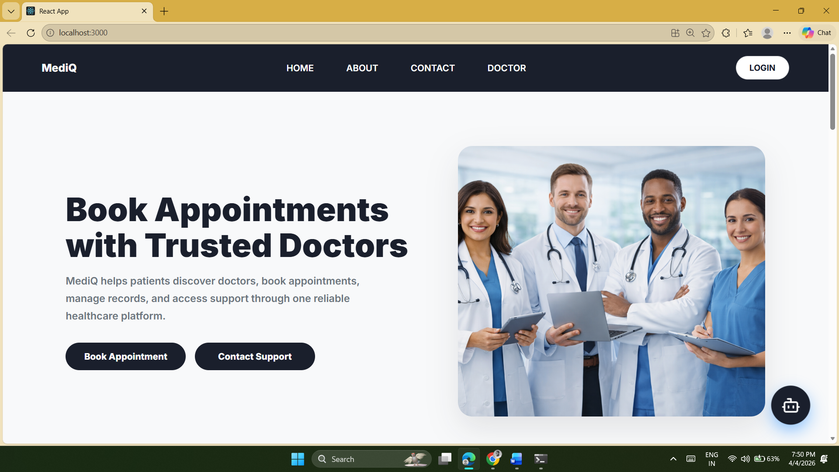
UI

Slide 43
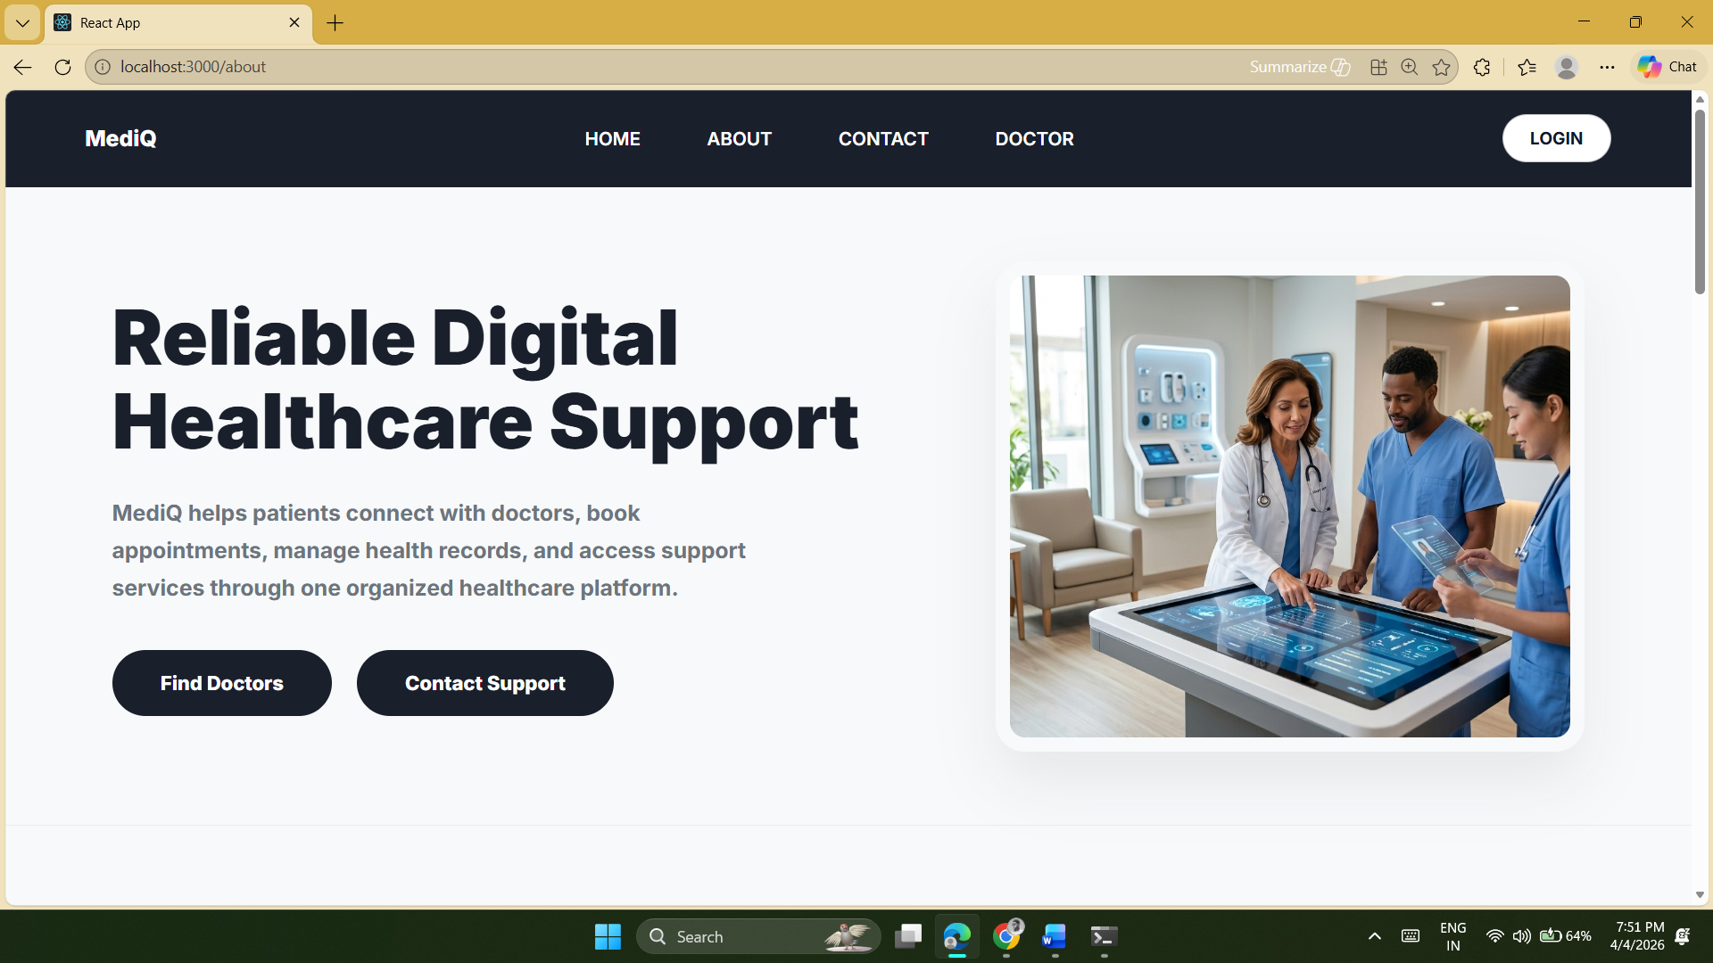
UI

Slide 44
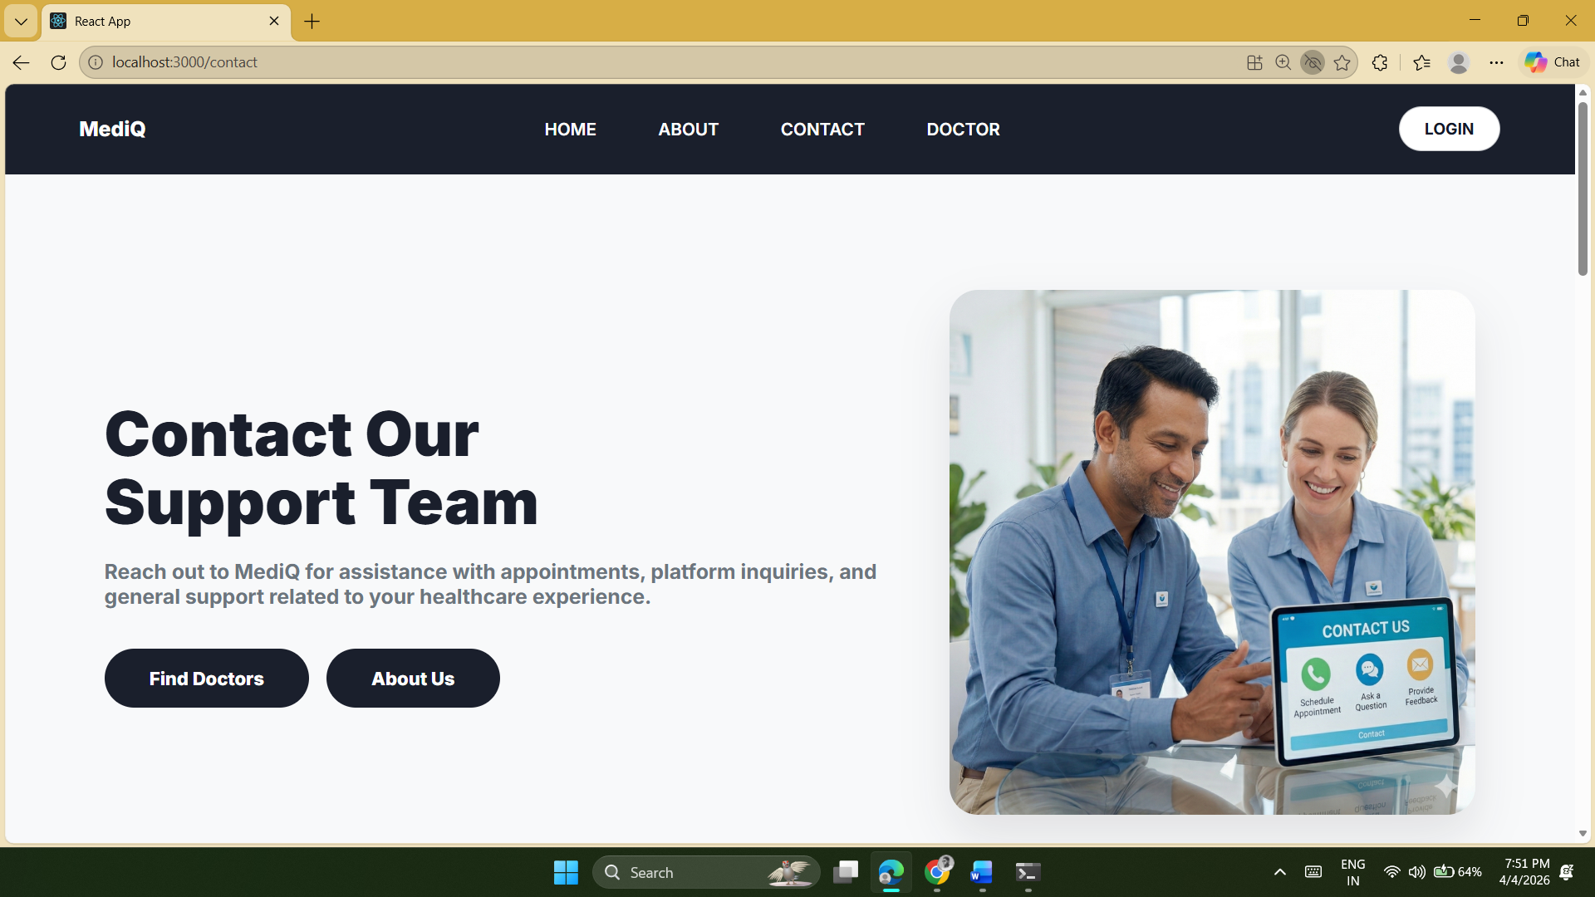
UI

Slide 45
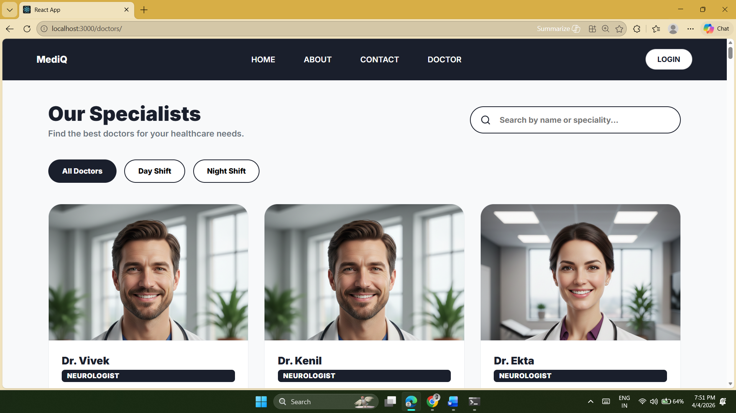
UI

Slide 46
PATIENT Test case
T_ID | PAGE | DATA | EXPECTED RESULT | ACTUAL RESULT | STATUS
1.1 | Patient Login | Valid Credentials | Redirect to Patient Dashboard | Home Page | PASSED
1.2 | Patient Login | Wrong Password | Error: "Invalid credentials" | Invalid credentials | FAILED
1.3 | Patient Reg | All Valid Fields | Account created successfully | Registered | PASSED
1.4 | Patient Reg | Existing Email | Error: "User already exists" | User already exists | FAILED

Slide 47
DOCTOR REGISTRATION Test case
T_ID | PAGE | DATA | EXPECTED RESULT | ACTUAL RESULT | STATUS
2.1 | Doctor Reg | All Docs Uploaded | Success: "Waiting for Admin Approval" | Waiting for Approval | PASSED
2.2 | Doctor Reg | Missing ID Proof | Error: "Documents Missing" | Documents Missing | FAILED
2.3 | Doctor Reg | Invalid Email Format | Error: "Invalid Email" | Invalid Email | FAILED
2.4 | Doctor Reg | Duplicate Email | Error: "Doctor already exists" | Doctor already exists | FAILED

Slide 48
DOCTOR LOGIN Tese case
T_ID | PAGE | DATA | EXPECTED RESULT | ACTUAL RESULT | STATUS
3.1 | Doctor Login | Approved Credentials | Success: "Login Successful" | Login Successful | PASSED
3.2 | Doctor Login | Unapproved Account | Error: "Doctor not approved yet" | Doctor not approved yet | FAILED
3.3 | Doctor Login | Wrong Password | Error: "Invalid credentials" | Invalid credentials | FAILED
3.4 | Doctor Login | Non-existent Email | Error: "Doctor not found" | Doctor not found | FAILED

Slide 49
ADMIN LOGIN Test case
T_ID | PAGE | DATA | EXPECTED RESULT | ACTUAL RESULT | STATUS
4.1 | Admin Login | admin@mediq / admin123 | Success: "Admin Login Successful" | Login Successful | PASSED
4.2 | Admin Login | Incorrect adminId | Error: "Invalid Admin ID" | Invalid Admin ID | FAILED
4.3 | Admin Login | Incorrect Password | Error: "Invalid Password" | Invalid Password | FAILED
4.4 | Admin Login | Empty Fields | Error: "Please fill out details" | Please fill out details | FAILED

Slide 50
BOOK APPOINTMENT Test case
T_ID | PAGE | DATA | EXPECTED RESULT | ACTUAL RESULT | STATUS
5.1 | Book Appt | All Fields Provided | Success: "Appointment booked" | Booked Successfully | PASSED
5.2 | Book Appt | Missing Time Slot | Error: "Missing required fields" | Missing fields | FAILED
5.3 | Update Stat | Status = "Approved" | Appointment reflects in Earnings | Status Updated | PASSED

Slide 51
Future Enhancement :-
Add Life Insaurance services.
Add Advance chatbot .
Add Video-Call Services on website.
Add Prescription Management services.
Buy medicine on website get discount on every buy.
Add Ambulance services.
Buy & Sell all medical equipment service.
Add services of notification on email & SMS.

Slide 52
References :-
React Official Documentation. Available at: https://react.dev
Express.js Official Documentation. Available at: https://expressjs.com
Node.js Official Documentation. Available at: https://nodejs.org
MongoDB Official Documentation. Available at: https://www.mongodb.com/docs
W3Schools. Available at: https://www.w3schools.com
GeeksforGeeks. Available at: https://www.geeksforgeeks.org
Stack Overflow. Available at: https://stackoverflow.com
ChatGPT. Available at: https://chatgpt.com
Google Gemini. Available at: https://gemini.google.com

Slide 53
THANK YOU

